Slide 1


CSE 455 Software Testing
Lecture 9
This course is offered to the students of students of BS Software Engineering who are enrolled in 8th semester

Slide 2
Course instructor Yella mehroze
yellamehroze@cuilahore.edu.pk

Slide 3

Security testing

Slide 4
Outline
Security Testing Objectives
Introduction
Motives for a Hacker
Threat Modeling
Steps of Threat Modeling Process
Buffer Overrun
Safe String Function
The JPEG Virus
Computer Forensics

Slide 5
Security Testing Objectives
To ensure that adequate attention is provided to identify the security risks,
To ensure that a realistic mechanism to define & enforce access to the system is in place,
To ensure that sufficient expertise exists to perform adequate security testing,
To conduct reasonable tests to confirm the proper functioning of the implemented security measures.

Slide 6
Introduction
Secure Product- A secure product is a product that protects
Confidentiality
Integrity
Availability
of the customers’ information and processing resources.
The product is usually under the control of System’s owner and Administrator.
Notes:
Confidentiality is to keep something secret or private.
Integrity means to prevent the system from unauthorized access

Slide 7
Introduction
Security vulnerability- A security vulnerability is a flaw in a product that makes it feasible for hacker for
Taking control over privileges on the user’s system
Regulating its operation
Compromising data
Even when using the product properly
Hacker
One who is proficient at using or programming a computer.
One who uses programming skills to gain illegal access to a computer network or file

Slide 8
Motives for a Hacker
Motives for a Hacker
Challenge/Prestige
Curiosity
Use/Leverage
Vandalize
Defacing
Destruction
Denial of Service
Steal

Slide 9
Motives for a Hacker
1. Challenge/Prestige
When someone breaks into a system purely for
The challenge of the task
The prestige of succeeding
There is no intent of threatening
2. Curiosity
Hackers do not stop at just gaining access.
He wants to look around to see what’s inside.
A software system could have vulnerability to be attacked that allows a hacker to gain access (challenge / prestige)
But still it may be secure enough to prevent the hacker from looking at its valuable data

Slide 10
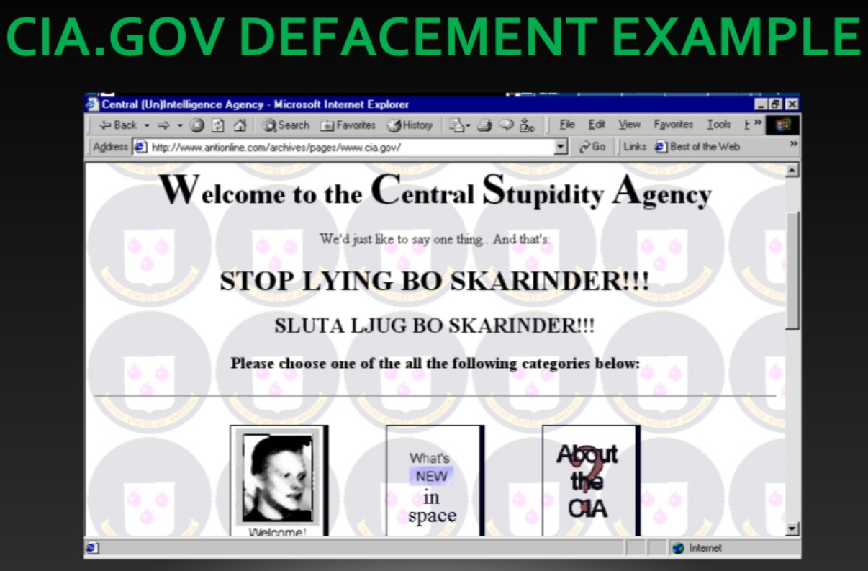
Motives for a Hacker
3. Use/Leverage
Here the hacker will actually attempt to use the system for his own purpose.
The hacker may be able to better cover his tracks by using hacked computers to do the damage
Example is an email virus
4. Vandalize- Remember 3 D’s
Defacing- changing the appearance of a website
to promote the opinion or thoughts of the hacker
Destruction- takes the form of deleting or altering of
data stored on the system
Denial of Service- is preventing or hindering the hacked
system from performing its intended operations
Notes:
In the picture, you can see example of defacing. CIA Government website has been hacked and the text appearing on the website has been changed.

Slide 11
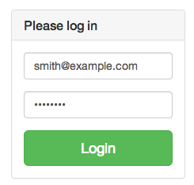
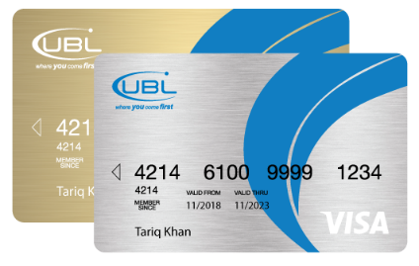
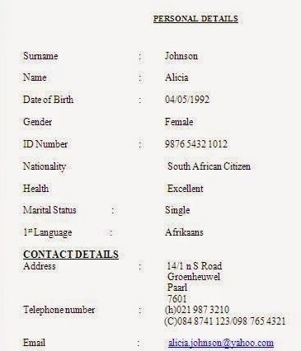
Motives for a Hacker
5. Steal
Most severe form of hacking is stealing
Intent is to find something of value that can be used or sold
Credit card numbers
Personal information
Login IDs
Email IDs
Examples:
In 2003, computer hacker gained access to and stole 92 million
AOL login ID’s.
The list was sold for amount up to $100,000
Worth $65 Million bit coins stolen from digital currency exchange

Slide 12
Threat Modeling
Threat modeling is a procedure which includes:
Optimizing network security by identifying objectives and vulnerabilities,
Defining countermeasures to prevent, or mitigate the effects of the threats to the system.
Review team examines the code to look for areas of the product’s feature set that are susceptible to security vulnerabilities
The team
Makes changes to the product
Spends more effort in designing these features
Concentrates testing on potential trouble spots
Performing threat modeling is not tester’s responsibility. Project manager is responsible

Slide 13
Steps of Threat Modeling Process
Assemble the Threat Modeling Team
Identify the Assets
Create an Architecture Overview
Decompose the Application
Identify the Threats
Document the Threats
Rank the Threats

Slide 14
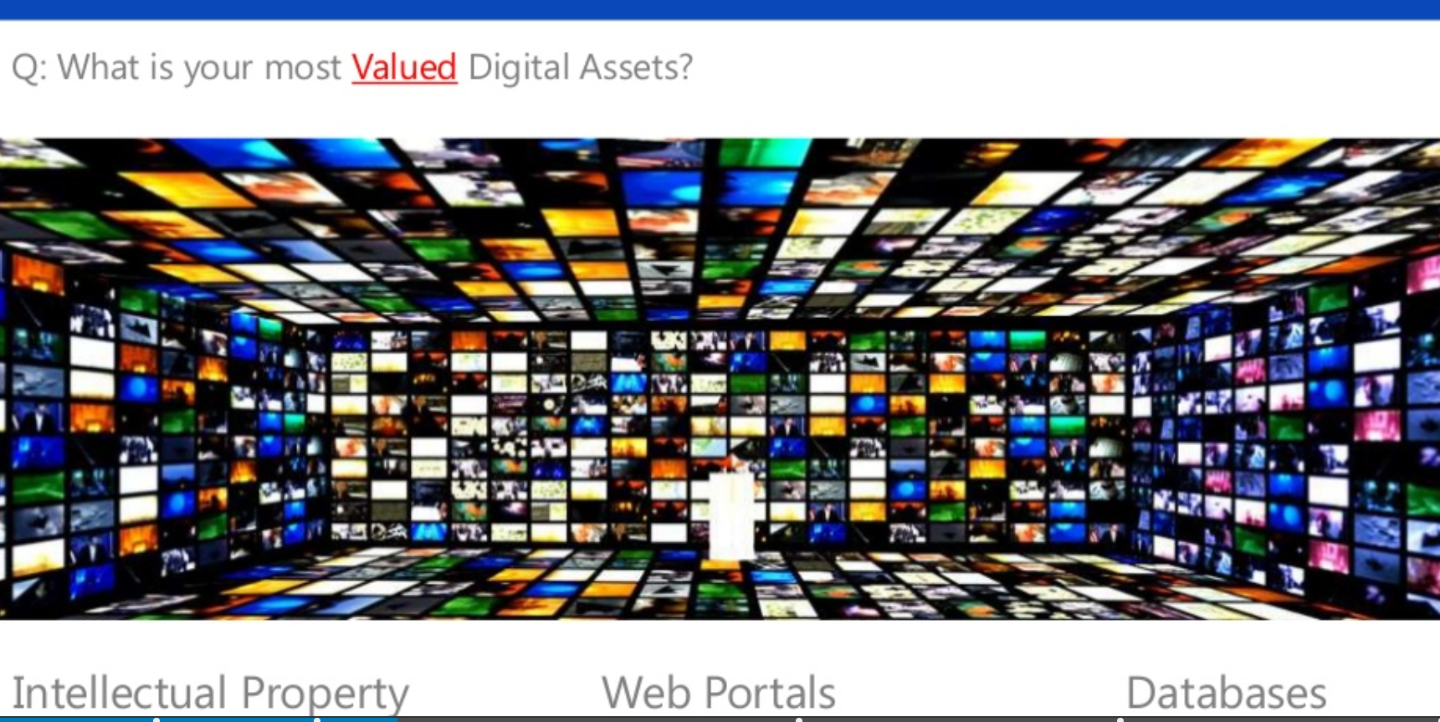
Steps of Threat Modeling Process
1. Assemble the Threat Modeling Team
Team members with software security background.
Outside consultant in case of small team.
In a large company, this person could come from a pool of experts, who float from one project to another
2. Identify the Assets
Think of all things that might be of value to
an intruder

Slide 15
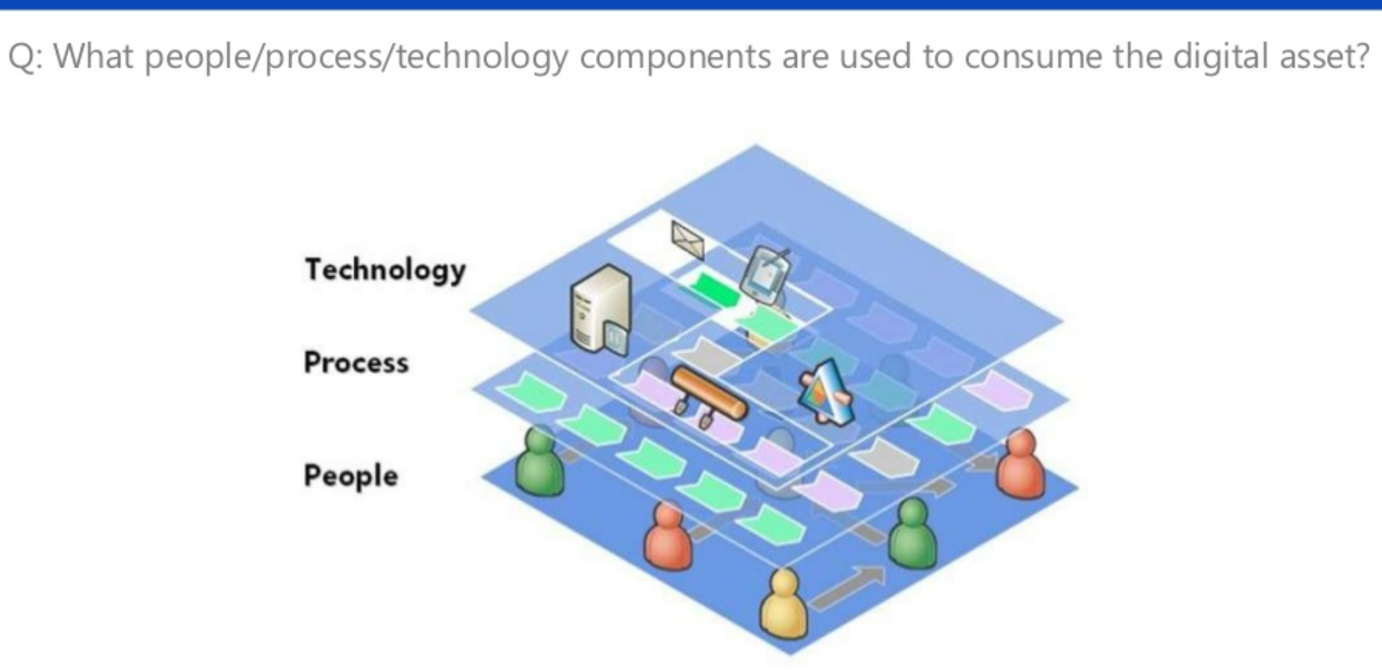
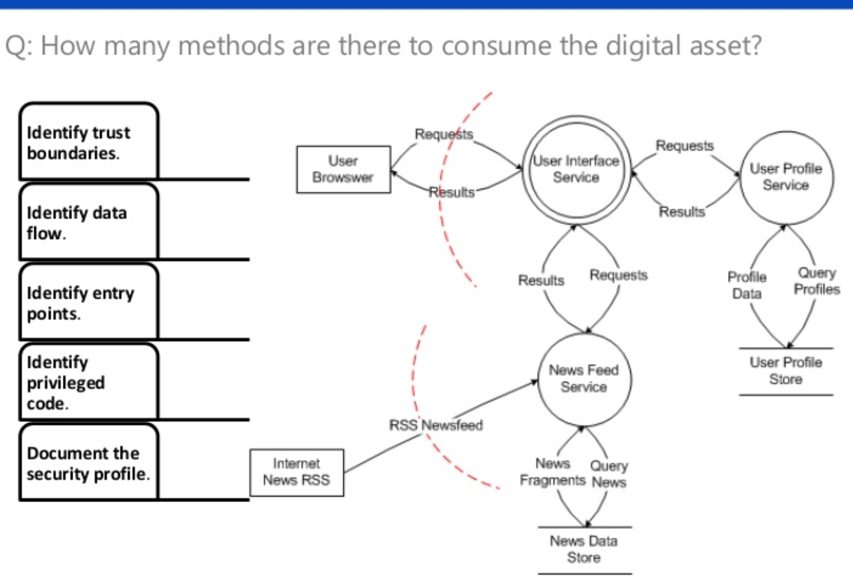
Steps of Threat Modeling Process
3. Create an Architecture Overview
Identify the technology you plan to use for your software and how it is interconnected.
For this purpose create an architectural diagram
Identify trust boundaries between different technologies
Identify authentication and authorization that must occur to gain access to the data
4. Decompose the Application
The process to identify how and where the data flows through the system
It is based on data flow diagrams and state transition maps
If these diagrams don’t exist, they will need to be created
Notes:
Create an Architecture Overview
Point 3: In simple words a trust boundary is the extent to which different technologies will interact and share information for the development of a product. You need to determine how secure it is.
Decompose the Application
Application is decomposed based on the flow of data.
RSS stands for Really Simple Syndication. It refers to files easily read by a computer called XML files that automatically update information.

Slide 16
Steps of Threat Modeling Process
5. Identify the Threats
After understanding components, team can move on to identify threats
Each of the components should be considered threat targets
You should assume that they will be attacked

Slide 17
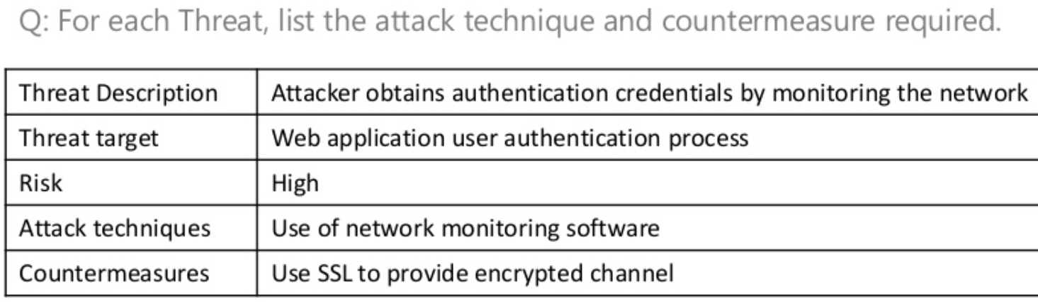
Steps of Threat Modeling Process
6. Document the Threats
Each threat must be documented and tracked to ensure that it is addressed
Documentation describes
What is the Threat to the system
Target
What form the attack might take
What countermeasures the system will use to prevent an attack

Slide 18
Steps of Threat Modeling Process
7. Rank the Threats
All threats are not created equal
You need to look at each threat and determine its ranking
Concepts Involved in Threats Ranking
Damage Potential
Reproducibility
Exploitability
Affected Users
Discoverability

Slide 19
Steps of Threat Modeling Process
Damage Potential- how much damage (Physical, Financial, Integrity and so on) could be done if a particular area is hacked
Reproducibility
How easy is it for a hacker to exploit the vulnerability consistently?
Would every attempt be successful?
One in 100 attempts?
One in million?
Exploitability
How technically difficult is it to gain access to the system or data?
Is it a few lines of code that can be emailed around the internet or does it require someone with expert programming skills?
Affected Users- If the hack succeeds, how many users will be affected?
Discoverability- What’s the likelihood that a hacker will discover vulnerability?

Slide 20
Steps of Threat Modeling Process
1=low, 2=medium, and 3=high system applied to each of the five categories
All values are summed and a value between 5 and 15 is achieved
Resolve the most severe issues first and then continue to lower ranked threats
Example:
D=Damage Potential
R= Reproducibility
E=Exploitability
A= Affected Users
D=Discoverability

Slide 21
Buffer Overrun
In buffer overflow, or buffer overrun, while writing data to a buffer, overruns the buffer's boundary and overwrites adjacent memory locations. This is a special case of the violation of memory safety.
A buffer is a sequential section of memory allocated to contain anything from a character string to an array of integers.
Writing outside the bounds of a block of allocated memory can corrupt data, crash the program, or cause the execution of malicious code.
Data reference errors- bugs caused by using a variable, constant, array or string that has not been properly declared or initialized for how it’s being used and referenced
It is the result of poor programming enabled by many languages such as C and C++

Slide 22
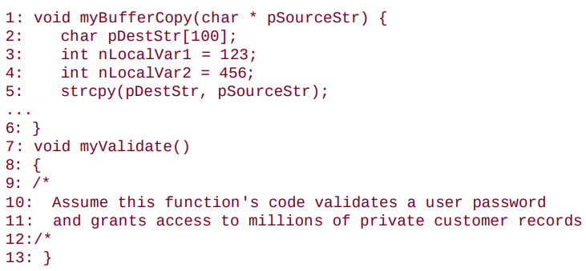
Example of Buffer Overflow
Notes:
In this slide, there are two functions.
myBufferCopy – used to copy the passed value through pointer parameter
My Validate – used to validate a user password
Do you see the problem? The size of the input string, pSourceStr, is unknown. The size of the destination string, pDestStr is 100 bytes.
What happens if the source string's length is greater than 100?
As the code is written, the source string is copied right into the destination string, no matter what the length. If it's more than 100 bytes, it will fill the destination string and then continue overwriting the values stored in the local variables.
Worse, however, is if the source string is long enough, it could also overwrite the return address of the function myBufferCopy and the contents of the executable code in the function myValidate(). In this example, a competent hacker could enter a super long password and override the intended password validation performed in myValidate possibly gaining access to the system.

Slide 23
Buffer Overrun
These types of bugs should be found as early as possible
Code review would find them early in the development cycle.
Software vulnerabilities can occur where you never expect them
A user may not ask for security, but he wants it and will consider the lack of security a bug

Slide 24
Safe String Functions
Microsoft identified C and C++ functions that were prune to buffer overrun
The usage of these functions in code require extensive error checking
So a new set of functions is developed that is thoroughly tested
These functions are called Safe String Functions
Safe String Functions are available for common operating systems, processors and compilers
Notes:
Point 2: These functions while using in the code required extra validation of the parameters passed to the functions to avoid buffer overrun. You have check the size/length of the parameters passed to the function and then use these values.

Slide 25
Benefits of Using Safe String Functions
Each function receives the size of the destination buffer as input
The functions null-terminate all output strings. The code performing an operation on the returned string can assume that eventually it will encounter a null-denoting the string’s end
All functions return an NTSTATUS value, with only one possible success code. The calling function can determine if the function succeeded in performing its operations
At the following link you can see different NTSTATUS values and their descriptions.
https://docs.microsoft.com/en-us/openspecs/windows_protocols/ms-erref/596a1078-e883-4972-9bbc-49e60bebca55
Each function is available in two versions. One support single-byte ASCII character and the other, double byte unicode characters to support multiple languages
Notes:
Point 2: Whenever you store data in a string/array in C or C++, you store a null value at the end of the data. When the string is read the null value indicates the end of the data in the string.
Point 3: NTSTATUS values are the return values or the codes that have mappings of the codes to a human-readable text message. There are codes available for both the success or failure messages. These are just like the windows error codes. Usually you do not have the understanding of the hidden meaning of these codes. But when you google it, you come to know that what is the problem and why this error message is appearing on the screen.

Slide 26
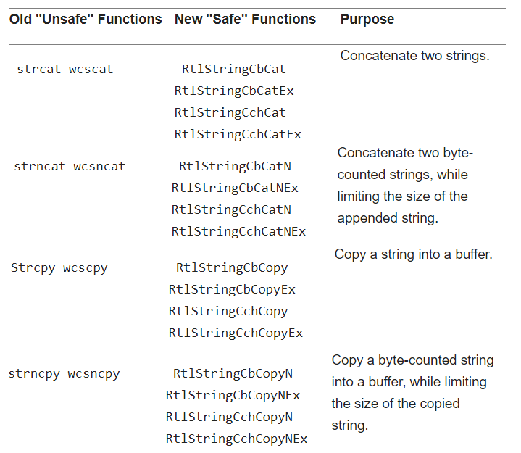
Old Unsecure C String functions and Their New Secured Replacements

Slide 27
The JPEG Virus
The JPEG file format, besides storing the picture element, also allows for the storing of embedded comments
This field is normally used for annotating the picture
This comment field starts with a hex value of 0xFFFE followed by a two byte value. This value specifies the length of the comment plus 2 bytes for the field length
A comment of up to 65533 bytes would be valid
If there is no comment, then the field is supposed to contain a value of 2
If comment is of size 65533 bytes then the total length will be 65533+2=65535
If the value in the field is illegal, a buffer overflow occurs
Notes:
It turns out that the code used to interpret the JPEG data and turn it into a viewable picture. It normalized the length by subtracting off the 2 bytes before it read out the actual comment. If the length byte was set to 0, subtracting off 2 yielded a length of -2. The code was written to handle positive integers and interpreted the negative 2 as a positive 4GB. The next 4GB of "comment" data was then loaded, improperly overwriting valid data and program. If that "comment" data was carefully crafted, it could be used to gain access to the viewer's PC. Microsoft had to issue a critical update to all the components that loaded and viewed JPEG images.

Slide 28
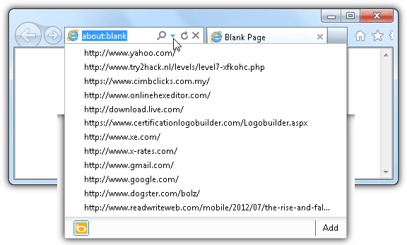
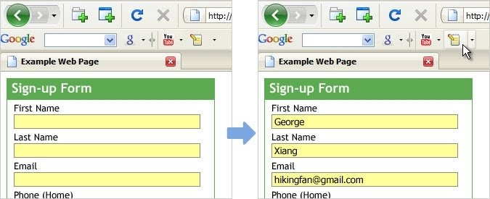
Computer Forensics
Sometime the data is just lying around for the viewing by those who know where to look
Internet explorer’s dropdown address bar displaying the history list of websites that have been recently visited
Google Toolbar Auto-fill feature allows you to store information such as your name, address, phone number, email address etc so that when a blank form is displayed, you can populate the fields with a single click

Slide 29
References
Chapter: 13
Book: Software Testing by Ron Patton Second Edition

